Slide 1

Mobile processor Architecture
By:
Rahul Pramod Krupani (1BM18IS077)
Pranav Deshpande (1BM18IS071)

Slide 2
Mobile processors
Mobile processors are different from normal computer processors not only in size, but in various other ways too
It works at a lower voltage than desktop computers and has better sleep mode capabilities (i.e. Parts can be turned off while not in use), which leads to cooler operation
The clock frequency in mobile processors is stepped down at lower loads, in order to prolong battery life

Slide 3
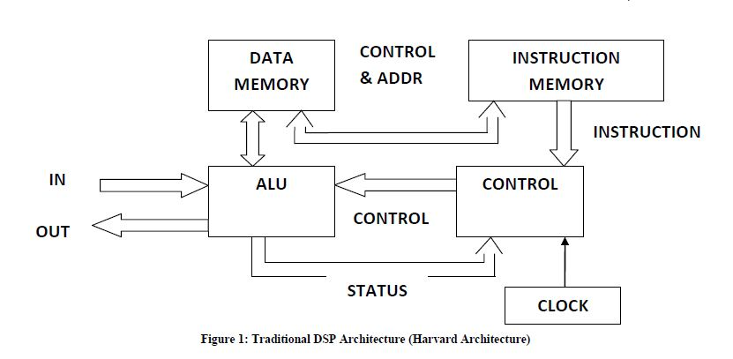
Digital signal processors
DSPs are speciallized microprocessors designed for mobile phones
They used to be designed around a single IC
Now Embedded DSPs are widely used for Very Large Scale Integration (VSLI) designs
VLSI is the process of combining millions of transitors onto a single IC, allowing it to contain a CPU, RAM, and ROM on a single chip
DSP made up most 2G systems and were extensively used in GSM

Slide 4
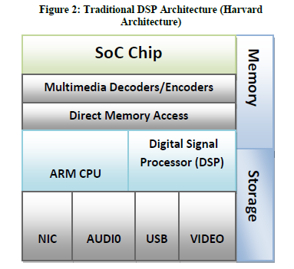
System on chip architechture
SoC is an IC which contain all the main components of a computer (CPU, memory, I/O, secondary storage)
It's multicore technology allows for higher performance with lower power
However, its high throughput requires faster memory systems (like cache)
To improve performance, certain companies do extensive instruction customization, by customizing instructions from 32-bit to 8-bit, we can greatly improve performance

Slide 5
ARM Processors
Most widely used architechture in modern smartphones
32- bit instruction set, based on RISC architecture
Low power consumption, great performance
ARMv5 & ARMv6 are used in low end devices
ARMv7 includes a hardware floating-point unit (FPU) providing improved speed
ARMv7-A is the most extensively used architehture

Slide 6
Comparing the most used mobile processors

Slide 7
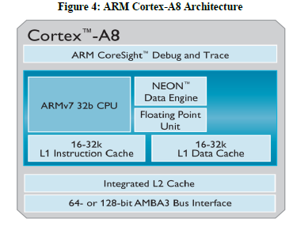
ARM cortex processors
The ARM Cortex-A8 is based on NEON SIMD processing technology, allowing for audio, video and 3D graphics
Implements Thumb-2 instruction set with 16-bit instructions
A single core ARM Cortex-A8 has a 1.4 GHz clock speed
In 2014, ARM processors clocked at 3 GHz became a reality
The latest architechture, the ARMv8, implements a 64-bit instruction set, provinding up to a 50% improvement in performance over the 32-bit models

Slide 8
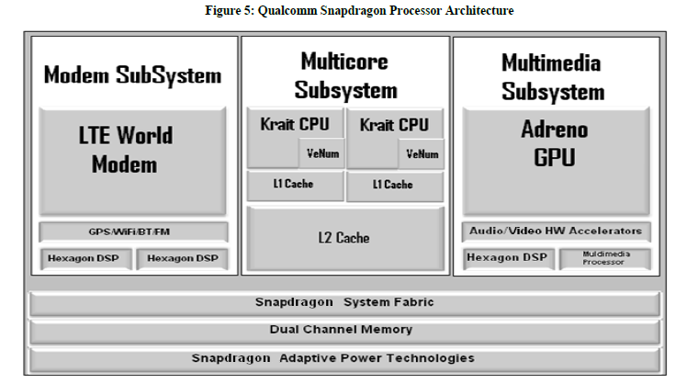
Qualcomm snapdragon processors
Snapdragon is a family of mobile system on a chip (SoC) processor architecture provided by Qualcomm
The original Snapdragon CPU had many features similar to the ARMv7
It is built on the Krait architecture, shown here
Integrates Long Term Evolution (LTE) modems, to provide support for 2G, 3G and 4G
It allows for up to 3 instructions per clock to be fetched and decoded

Slide 9
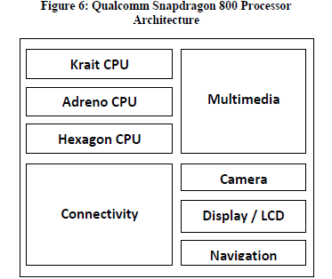
QUALCOMM SNAPDRAGON PROCESSORS
The Adreno GPU provides improved performance with advances graphics
The Hexagon DSPs provide low power operation for certain multimedia applications (like enhanced video/audio)
In 2013, the Snapdragon 800 outperformed every other chip on the market, clocking at 2.3 GHz
It could handle fast apps and web browsing, Ultra HD video, multichannel HD audio and stunning graphics

Slide 10
Nvidia tegra processors
It integrates ARM architecture CPU, graphics processing unit (GPU), memory controllers, etc. on a single package
The Nvidia Tegra 4 is a quad-core SoC using the Cortex-A15 processor with increased GPU cores, faster clock cycles and improved effiency
Its video processor has full support for decoding and encoding HD video

Slide 11

Thank you

